Slide 1
WWI… “The Lamps are going out all over Europe. We shall not see them lit again in our lifetime.”

Slide 2
Hero’s vs. Villains

Slide 3
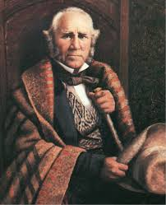
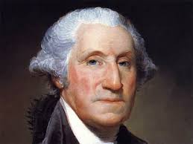
Hero’s

Slide 4
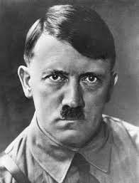
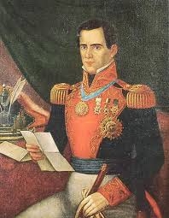
villains

Slide 5
Statistics
World population in 1914: 1.8 billion
US population in 1914: 99 million
Military deaths in world war I 11 million
Civilian deaths in world war I 7 million
Total Deaths in world war I 18 million

Slide 6
George santayana
“Those who cannot remember the past are condemned to repeat it.”

Slide 7
War facts
Britain began the war with 700,000 soldiers but by war’s end, 800,000 soldiers dies
Russia lost 3 million soldiers and they pulled out of the war a year early
France lost 1.4 million soldiers
Germany lost 2 million soldiers
United states lost 116,000 soldiers

Slide 8
Why did WWI occur?
Industrialization!!!!!!
Populations were increasing
Imperialism
Militarism

Slide 9
New era of military planning:
Europe’s army began to see their jobs as how to assure military advantage in an international crisis, not how to resolve it.

Slide 10
Emperor franz joseph-austria
Sensed that his dynasty’s thousand year reign was nearing an end, and he wanted to preserve it.

Slide 11
Czar Nicholas II- Russia
“ignoble war has been declared on a weak country. In the name of our old friendship (they were cousins) do what you can to stop your allies from going too far.”

Slide 12
Kaiser Wilhelm ii- Germany
“I am exerting my utmost influence to induce the Austrians to deal straightly to arrive to a satisfactory understanding with you.”

Slide 13
Unfortunately for the world: the leaders who had the power to advert a total war- nihilistically abdicated their power…., which anyone of them could have prevented WWI.

Slide 14
Greek term-Metanoia= Repentance
“to change one’s direction”, “to change one’s heart”, or “to change one’s mind”
There is no road down which we have traveled so far that we cannot stop and turn around and choose a different path.

Slide 15
So Abram rose, and clave the wood, and went, And took the fire with him, and a knife. And as they remained both of them together, Isaac the first-born spoke and said, My Father, Behold the preparations, fire and iron, But where’s the lamb for this burnt-offering? Then Abram bound the youth with belts and straps, And built fortifications and trenches there, And stretched forth the knife to slay his son. When lo! an angel called him out of heaven, Saying, Lay not thy hand upon the lad, Neither do anything to him. Behold, A ram, caught in a thicket by its horns; Offer the Ram of Pride instead of him. But the old man would not so, but slew his son, And half the seed of Europe, one by one.

