Slide 1
Steps Leading to
World War II

Slide 2
The Leaders
of WWII

Slide 3
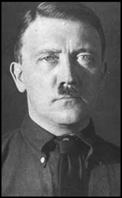
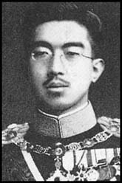
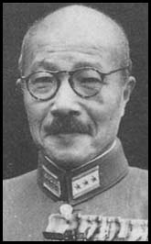
The Axis Powers
Adolf Hitler (1933) –
Germany
Hirohito
Hideki Tojo
Benito
Mussolini
(1922) - Italy
Emperor
Hirohito &
Military
Tojo
(1931) –
Japan

Slide 4
Germany
Italy
http://www.dean.usma.edu/history/web03/atlases/

Slide 5
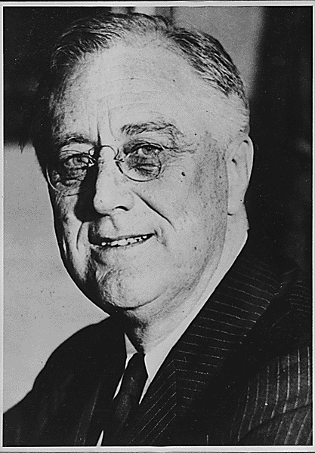
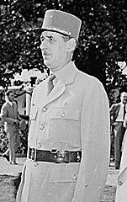
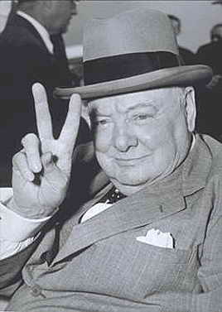
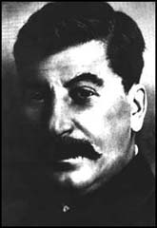
The Allied Powers
Franklin Roosevelt – U.S.A.
Winston
Churchill –
Great Britain
Charles DeGualle - France
Chiang
Kai-Shek –
China
Josef Stalin –
USSR

Slide 6
Great Britain
USSR
France
http://www.dean.usma.edu/history/web03/atlases/

Slide 7
The first Step to War…
Germany, Italy & Japan build up their militaries
Allied Response…
NOTHING

Slide 8
The Next Step to War…
In 1935, Italy attacks Ethiopia.
Why? (Ethiopia's Oil)
Allied Response…
League of Nations branded Italy
an aggressor & voted minor
Sanctions. Italy ignored these
sanctions, & the League did
NOTHING.

Slide 9
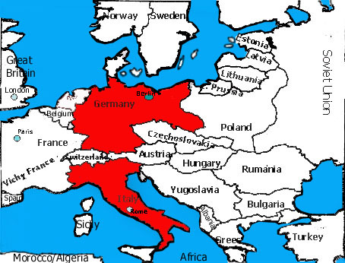

Slide 10
The Next Step to War…
In 1936, Germany & Italy officially form the Axis Powers.
Allied Response…
(1935) The U.S. Neutrality Act: wouldn’t allow the sale of arms to any country engaged in war.
Roosevelt starts checking out Europe’s militaries.

Slide 11
The Next Step to War…
In 1936, Hitler takes the Rhineland (Lebensraum?) which breaks the Treaty of Versailles!!
Allied Response…
NOTHING!

Slide 13
The Next Step to War…
In 1937, Japan opened a full scale war against China in order to get land & raw materials so Japan could grow economically.
Allied Response…
The US Neutrality Act continues; By 1940, US embargo on iron & steel exports to Japan.
(Japan is NOT happy!)

Slide 14
The Next Step to War…
What does Japan do on December 7th 1941, because of their anger over US embargo? .
Japan does not like the hypocrisy of the US.
Imperialism (Japan) is bad but Expansionism (USA) is good.

Slide 15
General Douglas MacArthur
will later orchestrate a theory
of Island Hoping to defeat Japan!
http://www.dean.usma.edu/history/web03/atlases/ww2%20pacific/ww2%20pacific%20%20pages/ww2%20pacific%20map%2002.htm

Slide 16
The Next Step to War…
In 1938, Hitler begins the purge of all the Jews, on Nov. 9, 1938, German citizens torched Jewish homes, businesses, etc. They called it “Kristallnacht” or “Night of Broken Glass”.
Allied Response:
NOTHING!!

Slide 17
Total Number of European Jews in 1933: 9,500,000
http://www.ushmm.org/museum/exhibit/focus/maps/

Slide 18
The Next Step to War…
In 1938, Germany forces the Austrian Government to resign, called the Anschluss (the Austrian Nazi Party controlled Parliament so they wanted Hitler to take over)
Allied Response…
NOTHING!!

Slide 19
http://www.dean.usma.edu/history/web03/atlases/ww2%20europe/ww2%20europe%20war%20index.htm

Slide 20
The Next Step to War…
In 1938, Hitler demands the Sudetenland (the western half
of Czechoslovakia).
Allied Response…
Munich Conference
Prime Minister Neville Chamberlain agreed to allow annexation to preserve “peace in our time.”(Appeasement?)

Slide 21
The Next Step to War…
Hitler takes the rest of Czechoslovakia 6 months later
Allied Response…
NOTHING!!

Slide 22
http://www.dean.usma.edu/history/web03/atlases/ww2%20europe/ww2%20europe%20war%20index.htm

Slide 23
The Next Step to War…
(1939) Germany & USSR promise to not fight each other and [secretly] divide up Poland (the Soviet Non-Aggression Pact).
Hitler’s real reason – He did not want to fight a war on two fronts.
Allied Response…
NOTHING!!

Slide 24
http://www.dean.usma.edu/history/web03/atlases/ww2%20europe/ww2%20europe%20war%20index.htm

Slide 25
The last Step to War…
No longer fearing a war on two fronts, Hitler invades Poland.
Allied Response…
WAR! Britain & France honor their guarantee to Poland and declare war on Germany.

Slide 26
WORLD WAR II !!
http://www.dean.usma.edu/history/web03/atlases/ww2%20europe/ww2%20europe%20war%20index.htm

