Slide 1
Renaissance

Slide 2
Renaissance
Renaissance – rebirth of art and learning from classics of Rome and Greece

Slide 3
Renaissance
4 reasons the Renaissance happened
Bubonic plague killed serfs
Crusades led to more trade opportunities with the east
Rise of a merchant class
Development of a commercial revolution

Slide 4
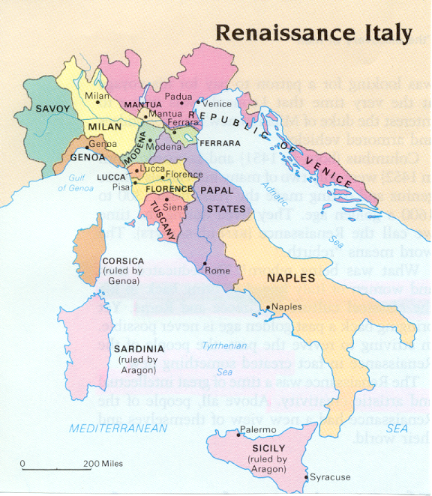
Italian City-States
Venice
Naples
Rome
Florence
Genoa

Slide 5
Renaissance
Merchants became the power in the Italian city-states
Florence became one of the most powerful city-states and they were ruled by the Medici family

Slide 6
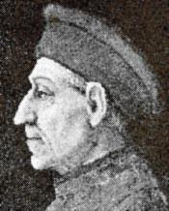
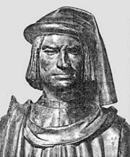
Cosimo de Medici
Lorenzo de Medici
The Medici’s supported the arts which made them patrons

Slide 7
Renaissance
Humanism
It is focusing on human potential and achievements
They studied Greek and Latin language manuscripts
They disliked Christian teachings
Their studies of history, literature, and philosophy made the subjects humanities

Slide 8
Renaissance
Renaissance men were concerned with the worldly or secular life.
To become a Renaissance man you had to be good in many fields like art, science, athletics, dance, play music and literature.

Slide 9
Renaissance
Women
Should know the classics and study
Do not create art they should inspire it

Slide 10
Renaissance
New emphasis on individuals, many painters painted portraits

Slide 11
Renaissance- Famous Artists
Donatello
Michelangelo
Leonardo Da Vinci
Raphael

Slide 12
Renaissance
Leonardo da Vinci became a true Renaissance man by being a painter, sculptor, and scientist

Slide 13
Universal Man = Renaissance Man
Baldassare Castiglione- wrote a book, “ The Courtier” in 1528, detailing what the expectations are for Nobles to fulfill these ideals in Renaissance society.

Slide 14
Renaissance
Writers
Wrote in Vernacular
First great writer was Petrarch- also known as the “Father of Italian Renaissance Humanism.”
Niccolo Machiavelli wrote The Prince where he states the end justifies the means

Slide 15
Northern Renaissance
Renaissance in the north began after the Hundred Years’ War
However, the Northern Renaissance included more religious ideas than the original Renaissance

Slide 16
Northern Renaissance
Great Painters of the Northern Renaissance:
Albrecht Durer who focused on realism
Hans Holbein- specialized in painting portraits, that are almost photographic in detail
Flemish Jan van Eyck- perfected the technique of oil painting.
Pieter Bruegel- captured scenes from everyday peasant life like weddings, dances, harvests, and changing of seasons.

Slide 17
Northern Renaissance
These Artists used oil-based paint because the paint does not dry quickly, it can blend more easily

Slide 18
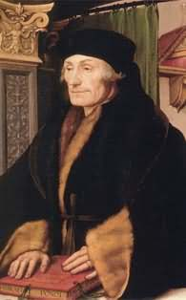
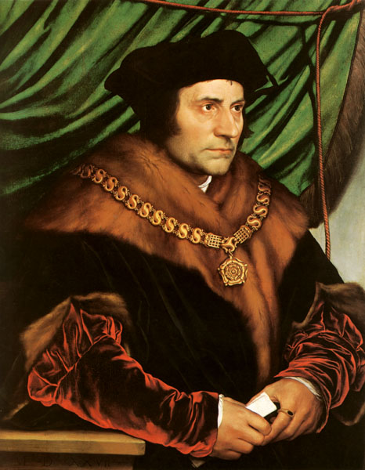
Two great Christian humanists
Desiderius Erasmus who wrote Praise of Folly
Thomas More who wrote Utopia which was the ideal place because there was no greed, war, or crime

Slide 19
Northern Renaissance
The greatest Renaissance writer in England was William Shakespeare who wrote MacBeth, Hamlet, etc…

Slide 20
Northern Renaissance
Shakespeare wrote during the reign of Elizabeth I, so England’s Renaissance is called the Elizabethan Age

Slide 21
Northern Renaissance
Johann Gutenberg invented the printing press which changed history.
The first book he ever printed was???
The Bible called the Gutenberg Bible

Slide 23
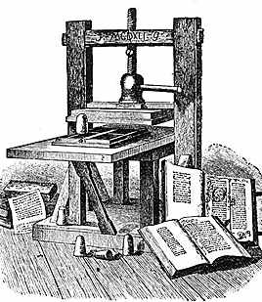

Slide 24
Northern Renaissance
The printing press changed society by
Making books cheap = more people bought them = higher literacy rate
More people also could read the Bible and interpret what it said by themselves = lead to the Reformation which ended the Renaissance

